Slide 1
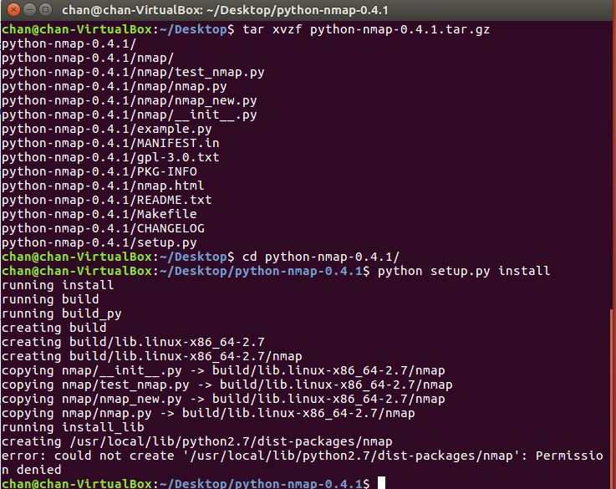
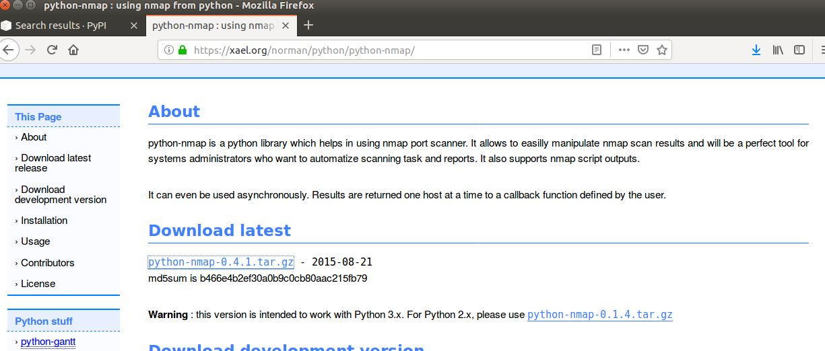
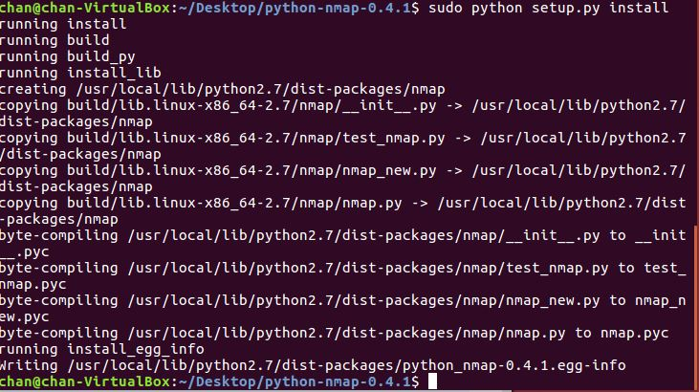
Week #1
Getting Library
Python-nmap

Slide 2
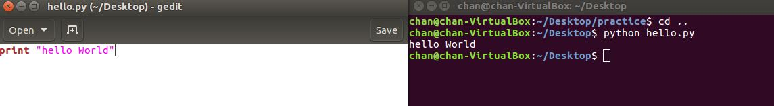
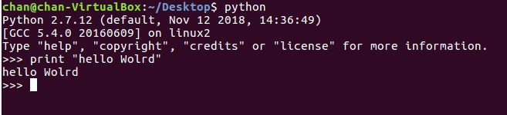
Week #1
Python
Install and Execute
Two mode
i)
ii)

Slide 3
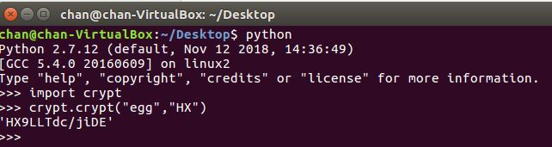
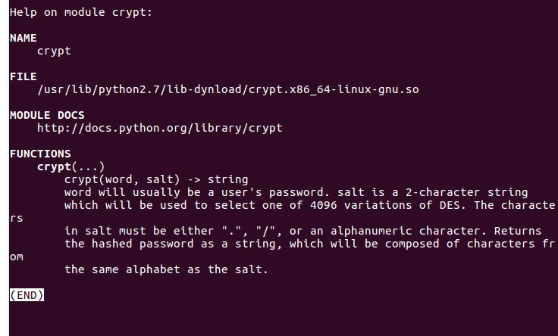
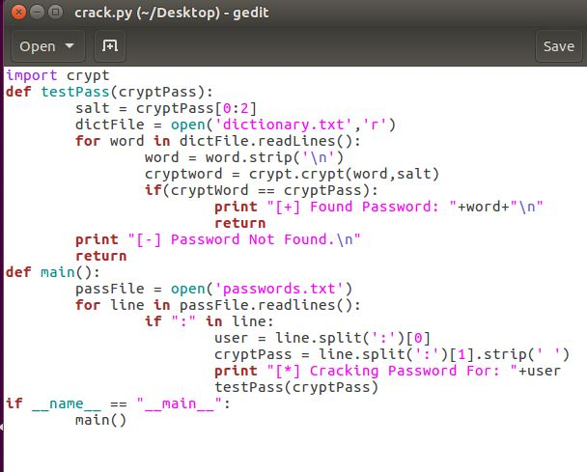
Week #1
First Script – Unix Password Cracker
Finding Password w/ Dictionary Attack

Slide 4
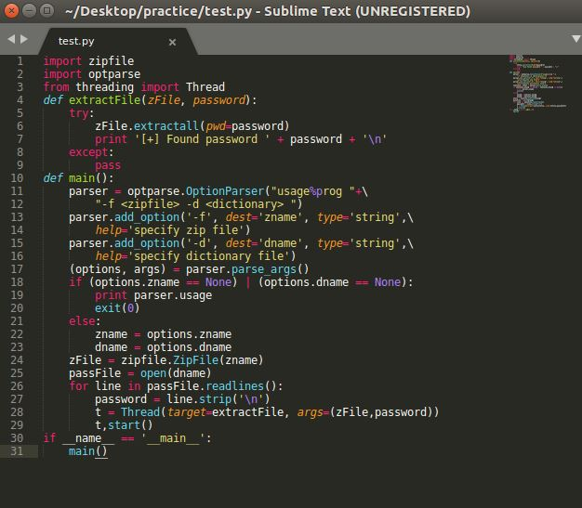
Week #1
ZipFile Password Cracker
IF wrong password -> error -> make exception -> FIND Password!

